Slide 1


DEPARTMENT OF COMPUTER SCIENCE AND ENGINEERING
20CS8504 & PROJECT WORK
END SEMESTER PRACTICAL EXAMINATION - MARCH - 2026
Batch No.: 14
Date: 30-03-2026
Session: AN

Slide 2
AI BASED CYBERBULLYING IN SOCIAL MEDIA USING NATURAL LANGUAGE PROCESSING
Guide Name:
Mr. M. A. PRASANNA B.E., M.Tech.,
Team Members:
ABINAYA SHREE J (811722104004)
CHARULATHA K (811722104023)
HARSHITHA K (811722104052)

Slide 3
OBJECTIVE OF THE PROJECT
Develop Twitterly, a full-featured Twitter-like social media web application using Django, supporting user registration, tweet posting (with images), commenting, liking, retweeting, following, notifications, and profile management.To analyze text data and identify offensive, abusive, or harmful language.
To build a system that automatically flags or alerts when cyberbullying content is detected.
To improve the safety and well-being of social media users by reducing online harassment.

Slide 4
INTRODUCTION
Social media enables instant global communication and sharing of ideas, but its rapid growth has also fueled a sharp rise in cyberbullying — online harassment, threats, and insults.
Victims often suffer serious psychological harm, including stress, anxiety, depression, and in extreme cases, self-harm.
With massive volumes of content posted every second, manual moderation is impractical — hence the urgent need for an automated real-time detection system to identify and prevent cyberbullying on social platforms.

Slide 5
LITERATURE SURVEY
TITLE | AUTHORS | PAPER GIST | TECHNOLOGY USED
Detection of Cyberbullying on Social Media Using Machine learning | Varun Jain, Vishant Kumar,Vivek Pal | NLP techniques analyze social media text to automatically identify abusive online behavior and improve online safety. | NLP,ML AND NLTK
Advancing Hate Speech Detection with Transformers: Insights from the MetaHate | Santosh Chapagain, Shah Muhammad Hamdi, Soukaina Filali Boubrahimi | The paper explores transformer-based methods for more accurate hate speech detection. | Transformer models (BERT, RoBERTa, ELECTRA, GPT-2)
Advancing cyberbullying detection in low-resource languages: a transformer-stacking framework for Bengali | Md Nesarul Hoque 1,2, Rudra Pratap Deb Nath 1, Abu Nowshed Chy 1, Debasish Ghose 3,*, Md Hanif Seddiqui. | The paper proposes a transformer-stacking model to improve cyberbullying detection in Bengali social media text. | Transformer-stacking ensemble (XLM-R-base, multilingual BERT / mBERT, Bangla-BERT-Base)

Slide 6
LITERATURE SURVEY
TITLE | AUTHORS | PAPER GIST | TECHNOLOGY USED
Automated Hate Speech Detection and the Problem of Offensive Language | Thomas Davidson, Dana Warmsley, William Macy, Ingmar Weber | The study explores automated methods for identifying hate speech in social media text. | Traditional ML (Logistic Regression, SVM, Naive Bayes, Random Forests) with TF-IDF n-grams
Leveraging Transformers for Detection of Arabic Cyberbullying on Social | Amjad A.Alsuwaylimi,Zaid S.Alenezi | proposes hybrid transformer models to improve Arabic cyberbullying detection on social media. | Hybrid transformers (CAMeLBERT + AraGPT2 fusion, AraBERT + XLM-R)
Multi-Lingual Hate Speech Detection from Tweets Using Pre-Trained Transformers | Muhammad Ahmad ,MuhammadWaqas,AmeerHamza,SardarUsman and Grigori Sidorov | The paper proposes hybrid transformer models to improve Arabic cyberbullying detection on social media. | re-trained transformers (BERT, RoBERTa variants) for multilingual (Arabic + Urdu) hate speech

Slide 7
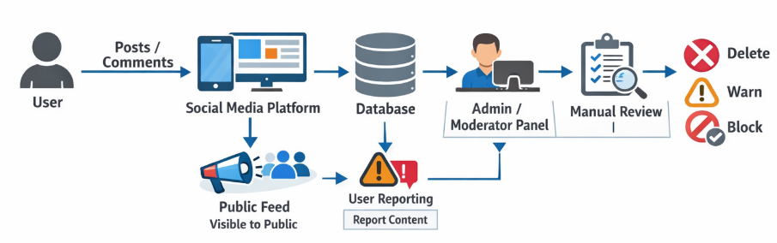
EXISTING SYSTEM ARCHITECTURE

Slide 8
PROBLEM IDENTIFICAITON
Most social media platforms rely heavily on manual reporting of abusive content, which can delay action against harmful messages.
Existing systems often fail to detect subtle forms of cyberbullying, such as sarcasm, disguised insults, or coded language.
Due to the huge volume of social media posts, human moderators cannot monitor all content effectively.
Victims of cyberbullying may suffer psychological harm before harmful content is identified and removed.
Current solutions may not analyze contextual meaning in text, leading to ineffective detection.

Slide 9
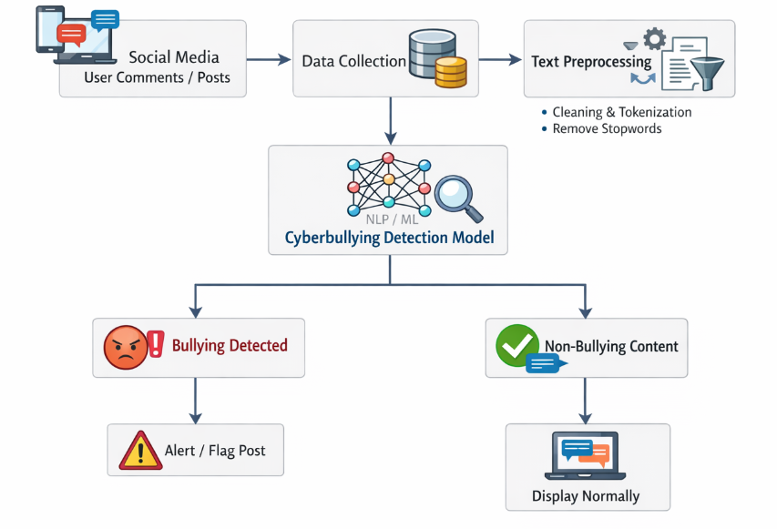
PROPOSED SYSTEM ARCHITECTURE

Slide 10
SOFTWARE AND HARDWARE REQUIREMENTS
HARDWARE
Processor: Intel Core i3/AMD Ryzen 3 or higher (2.0 GHz+)
RAM: Minimum 4 GB (8 GB recommended for ML training)
Storage: Minimum 10 GB free disk space
SOFTWARE
1. Operating System: Windows 10/11, Ubuntu 20.04+, or macOS 12+
2. Web Framework: Django 4.2 or higher
3. NLP Library: NLTK 3.7+

Slide 11
MODULES
1. Accounts Module
2. Tweets Module
3. Notifications Module
4. Machine Learning Engine Module
5. Admin Portal Module

Slide 12
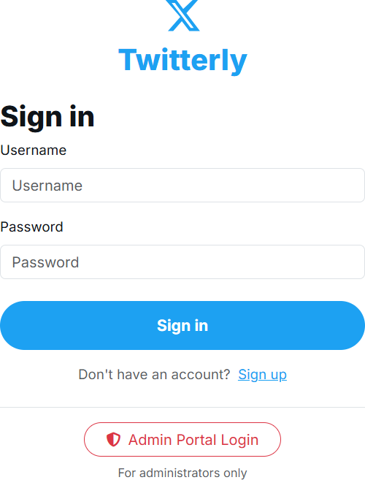
ACCOUNTS MODULE
Collects Manages complete user lifecycle including registration, login/logout, password reset, and secure authentication using Django’s built-in system with custom user fields.
Allows users to create and edit profiles (bio, profile picture, cover photo, location, website) and handles social connections via following/unfollowing.
Tracks moderation status for each user (warning count, is_warned, is_blocked) to support graduated enforcement actions from the admin side.

Slide 13
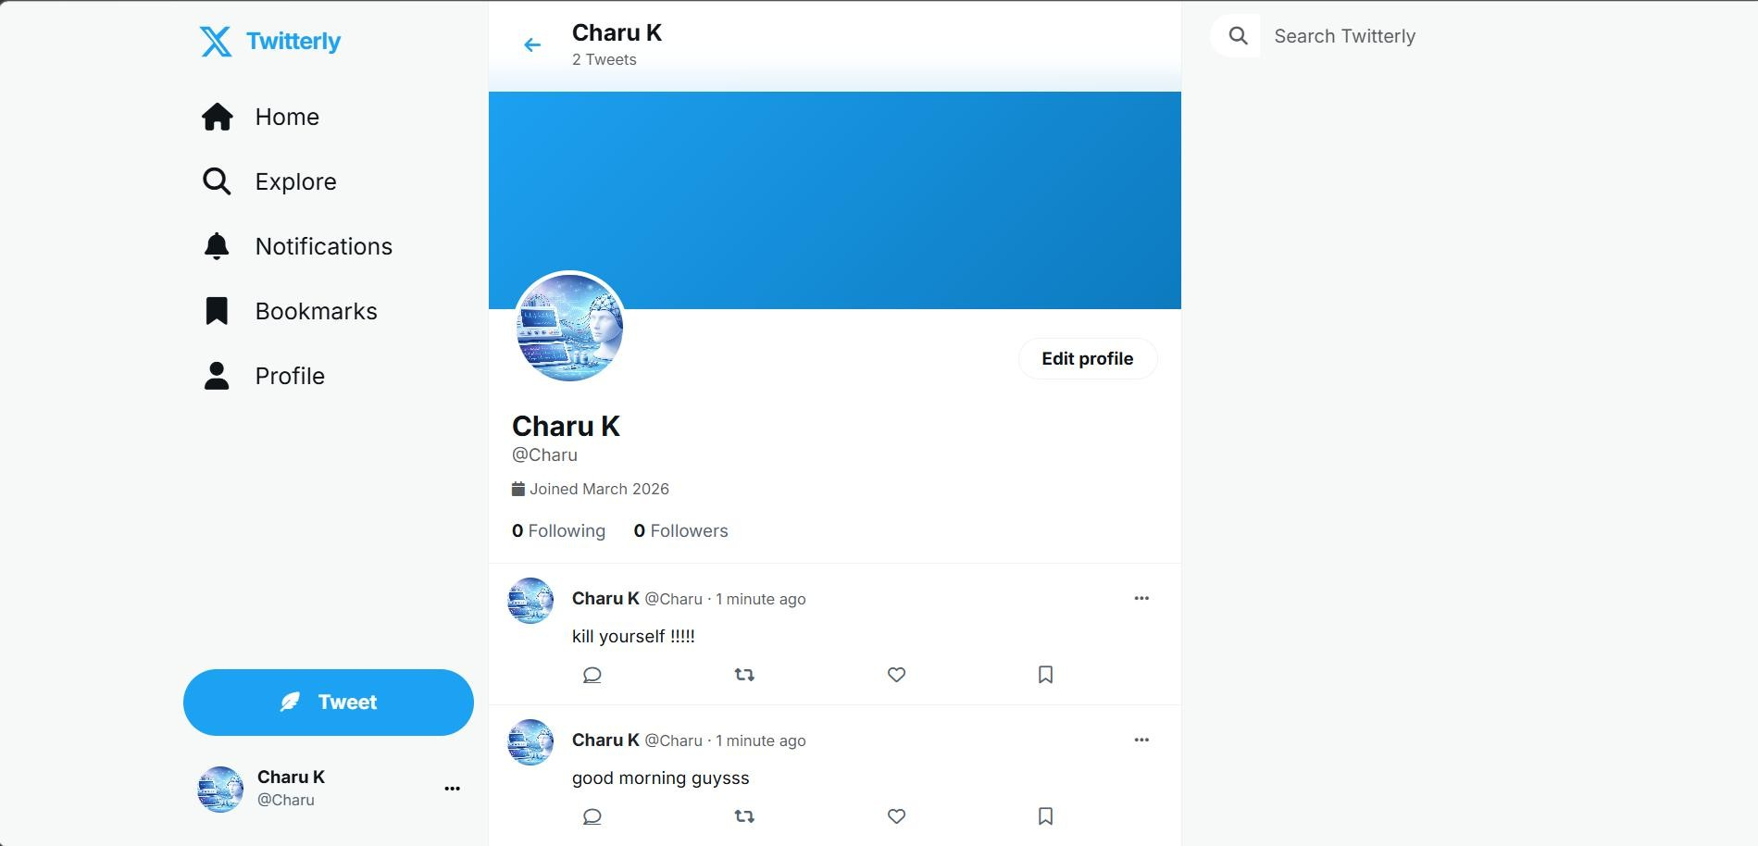
TWEETS MODULE
Enables creation of tweets (up to 280 characters) with optional image upload, supports commenting/replies (threaded), liking, retweeting, quote tweeting, and bookmarking.
Automatically extracts and links hashtags, handles soft deletion for flagged content, and provides explore/search functionality for discovering posts.
Triggers the Machine Learning Engine in real-time for every new tweet or comment to perform cyberbullying/hate speech detection before visibility.

Slide 14
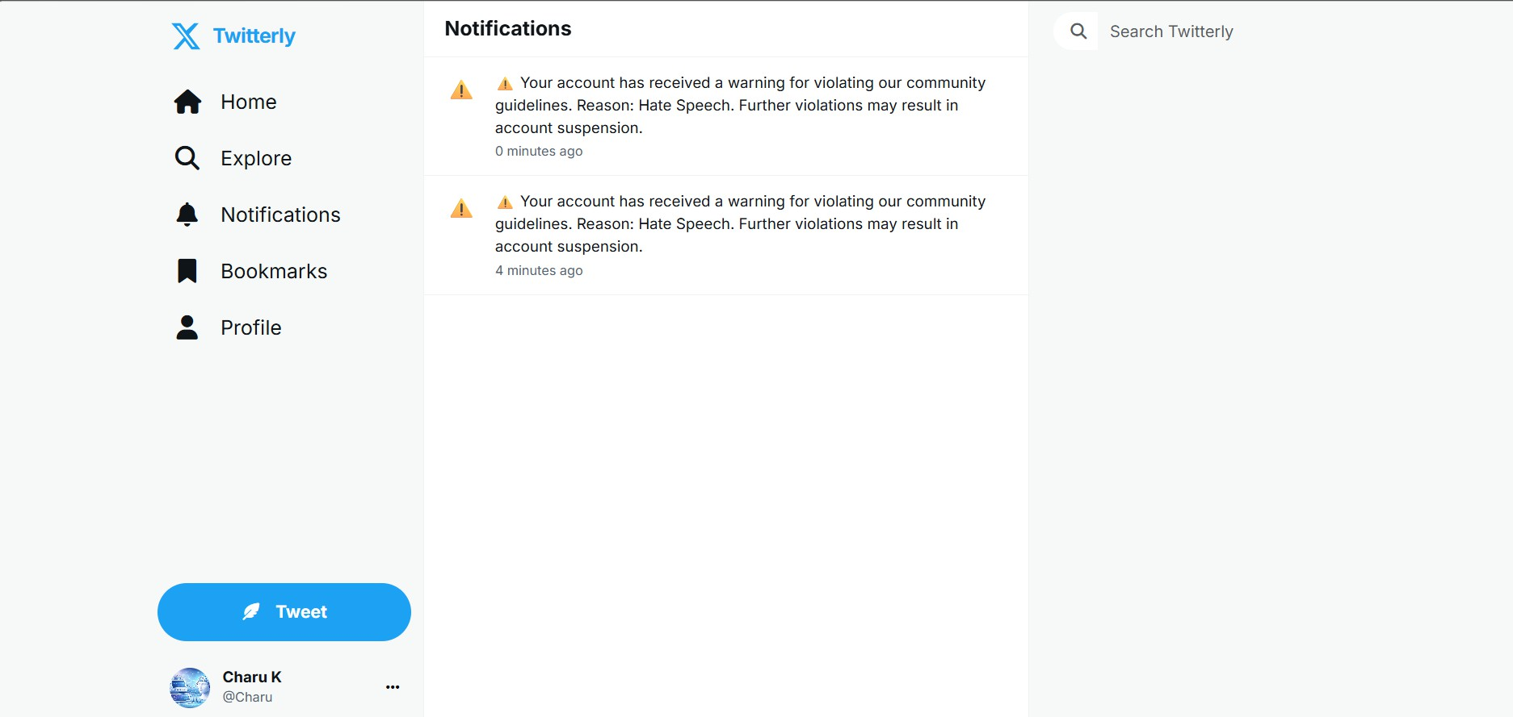
NOTIFICATIONS MODULE
Generates real-time event-based alerts for user interactions such as likes, retweets, comments, new followers, mentions, and replies.
Also delivers moderation-related notifications (warnings, post deletions, account blocks) to keep users informed of administrative actions.
Maintains read/unread status, shows unread count badge in the UI, and uses a context processor for global availability across pages.

Slide 15
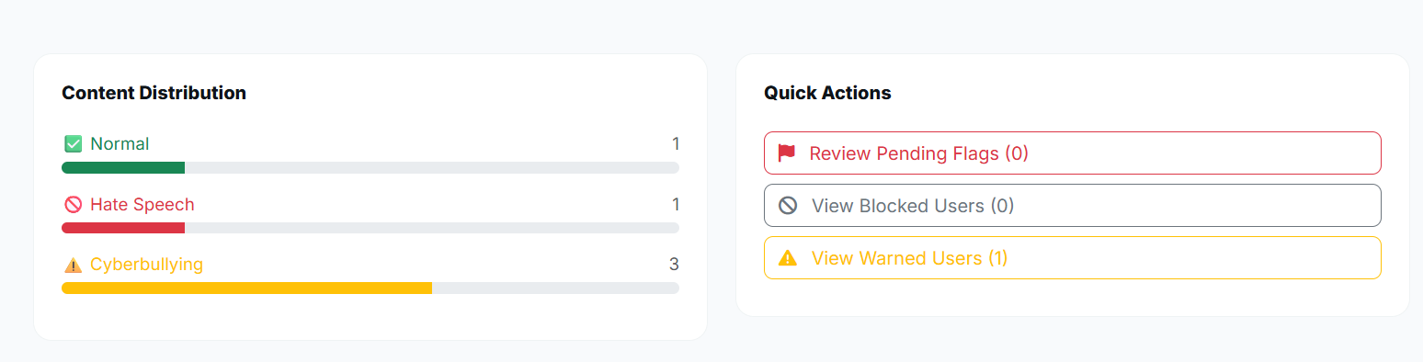
MACHINE LEARNING ENGINE MODULE
Implements full NLP preprocessing pipeline using NLTK: tokenization, stop-word removal (preserving negations), and WordNet lemmatization on incoming text..
rains and compares four model configurations (Logistic Regression & LinearSVC × TF-IDF & Bag-of-Words), automatically selects and deploys the best model based on weighted F1-score.
Performs real-time inference (<350 ms) on every post/comment, returns label + confidence score, and silently flags harmful content for admin review.

Slide 16
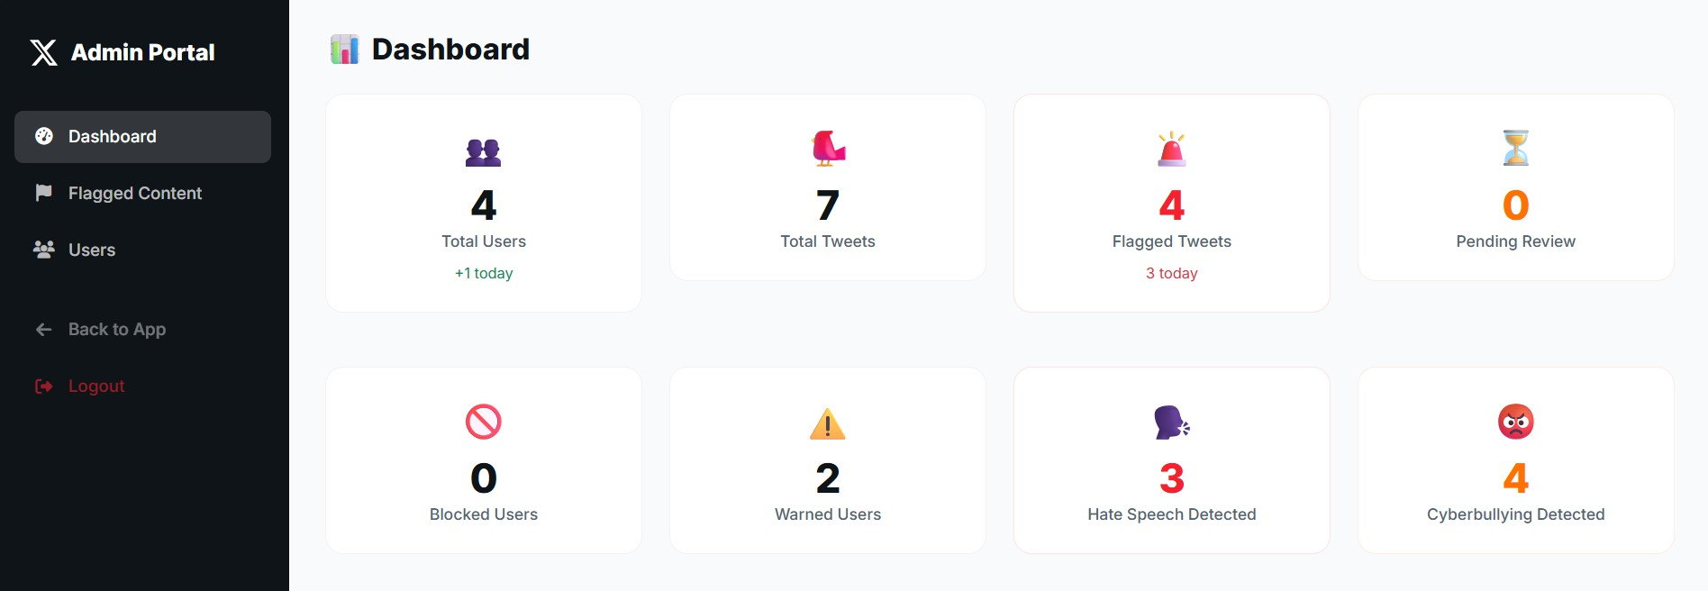
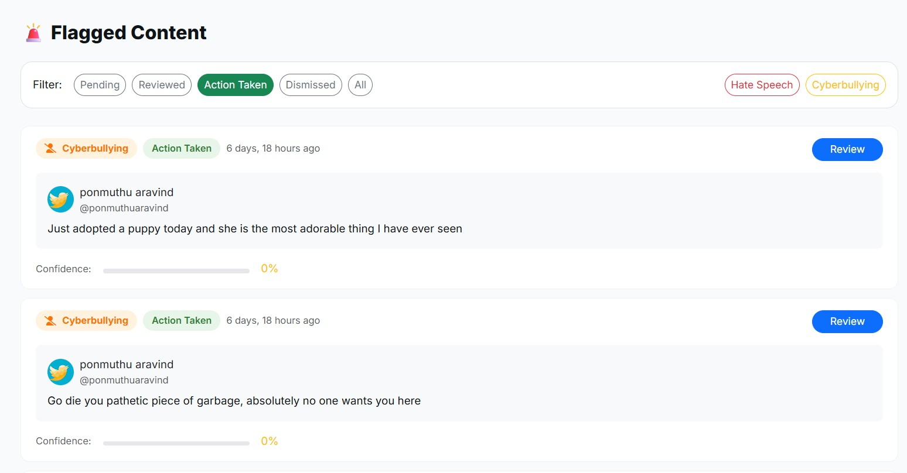
ADMIN PORTAL MODULE
Provides a secure, staff-only custom dashboard (separate from default Django admin) showing statistics: total users, tweets, flagged posts, blocked accounts, and ML performance metrics.
Displays filterable list of flagged content with full context, original text, predicted label, and confidence score for quick moderator review.
Supports graduated moderation actions: dismiss (false positive), warn user, delete post, increment warning count, or permanently block user — with audit logging and notifications.

Slide 17
CONCLUSION
The project presents an effective solution for detecting cyberbullying on social media using NLP and machine learning. By integrating real-time analysis into a Django-based platform, it helps identify harmful content quickly and improve user safety. The system is efficient, scalable, and provides a strong foundation for building safer online communities with scope for future enhancements.

Slide 18
FUTURE ENHANCEMENTS
The system can be enhanced by supporting multiple languages such as Tamil and Hindi, allowing it to detect cyberbullying across a wider range of users. It can also be extended to analyze images and memes along with text, improving the overall detection capability.
Additionally, the use of advanced deep learning models like BERT can improve accuracy by better understanding context, sarcasm, and hidden meanings. The system can further be improved by incorporating continuous learning from user feedback, helping it adapt to new patterns of abusive language over time.

